Slide 1


Sam’s Club Attribute Based Assortment
Team 07: Noa Scharf, Hector Negron, and Benjamin Tutka
Sam’s Club Team: Michael Juang, Nikhil Sharma, and Ada Shi
Date Presented: April 29th, 2025

Slide 2



Our UARK Data Science Team
Ben Tutka
Hector Negron
Noa Scharf

Slide 3



Our Sam’s Club Team
Michael Juang
Principal Data Scientist
Nikhil Sharma
Data Scientist
Ada Shi
Director, AI

Slide 4
Project Roadmap
Business Research
Business & Previous Approaches Research, Data Requirements
The Data
Demographic Feature Engineering & Internal Sam's Data, One Hot Encoding for Data
EDA
EDA, Clustering, and Sales Analyses
Modeling
Understand the Model
Conclusions
Key Takeaways
Running and Comparing Different Models & Choosing One to Move Forward With
After Running, Get Results to Understand the Model
Drawing Conclusions from the Results that were Pulled
Overall Project Key Takeaways

Slide 5
Background Information

Slide 6
Who is Sam’s Club?
About Sam’s Club
Growth & Expansion
What is our Challenge?
Membership-based warehouse, founded by Sam Walton
Provides value & quality through a curated assortment of products
Allows members to access savings in bulk
Sam’s Club has nearly 600 store locations across the U.S., Puerto Rico, with additional clubs in China, and Mexico
Data given for United States (includes Puerto Rico)
Serve millions of members through different channels
In-store
Online
We are tackling the challenge of optimizing product assortment
Stemmed from:
Diverse store layouts
Sam’s Club growth
Shift towards multi-channel fulfillment

Slide 7

How Have We Prepared for This Challenge?
McKinsey’s Analytical Assortment Optimization:
Data driven SKU rationalization: Keeping high impact SKUs based on customer behavior
Customer-centric approach: Focus on understanding customer needs
Regional tailoring: Tailoring assortments based on regions and store type
Kroger’s Space Optimization:
Enhanced customer experience: Optimized shelf space to reflect local preferences
Data-driven decisions: Uses insights and buying patterns to allocate space

Slide 8
Business Understanding
Traditional vs. The New Approach
Our Key Questions
What is Our Goal?
Moving from a top-down space allocation to a data-driven “bottom-up” approach
Utilizing item-level data and machine learning to tailor assortments to local dependencies and preferences
Are some clubs better at aligning assortments with member profiles, and does this drive financial performance?
Do there exist relationships between club attributes and certain subcategory sales?
If so, are the relationships common for all subcategories, or variable across GMMs?
Identify relationships between club attributes/demographic data and sales performance.

Slide 9
Our Data Process
Identify feature engineering data – demographics & income
Aggregated Sam’s Club data to this
Obtained club attribute data
Combined attribute data to demographics
One hot encoded variables needed for clustering
Performed clustering analysis on data
Access to Databricks granted by Sam’s Club
Obtained item sales data – POS data

Slide 10
Exploratory Data Analysis

Slide 11
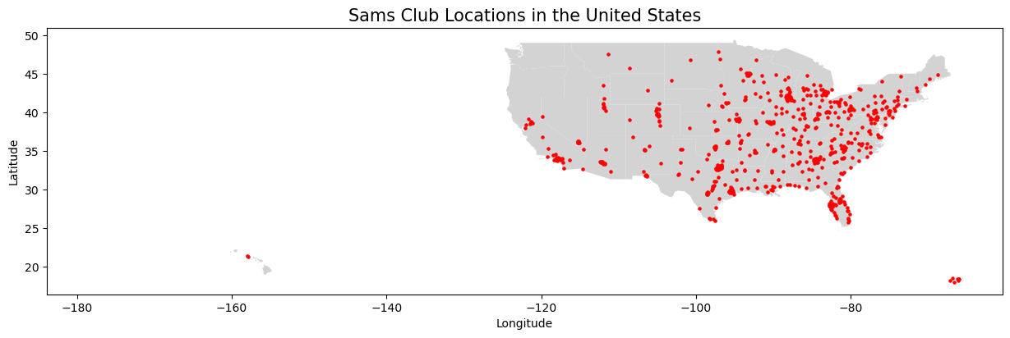
Where Are Our Stores Located?
Data is from United States and Puerto Rico store locations
Graphed using geographical data from club data

Slide 12
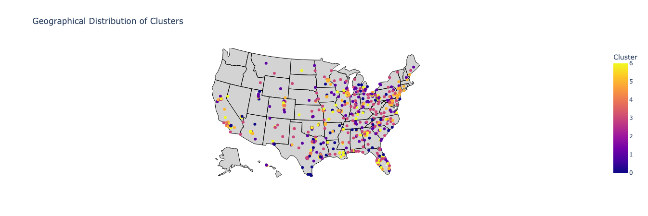
Our Clustering Analysis
Clustering analysis based on key demographic features
7 clusters

Slide 13
Modeling

Slide 14
Models Constructed – Four Types
Linear Regression
Simplest type of model, good at capturing linear relationships between predictors and response. Decent performance, but struggled with categorical variables.
CatBoost
Advanced gradient-boosting model which handles categorical variables natively. That is, no user encoding is required to process non-numeric data
XGBoost
Utilizes gradient boosted decision trees, similar to CatBoost but requires encoding of non-numeric data. Good at capturing complicated relationships, but can overfit simpler ones.
Random Forest
Uses a series of decision trees to reach a singular result. Averages the predictions of each tree to produce a singular predicted value for the target variable.

Slide 15
Strongest Model: CatBoost
Variable Data Types
Combined Relationships
Feature Importances
CatBoost easily handles both categorical and numeric data, making it especially useful for our combination of datasets.
The model is able to detect both linear and non-linear relationships between features and response
There is a built-in function for pulling the feature importances from CatBoost models, which was our primary goal

Slide 16
CatBoost Model Implementation
Inputs
Outputs
Dataset partitioned by subcategory
A model was made for each individual subcat, with data from all stores with significant sales for that subcategory
After prepping the data in Python using a processing function, models were executed using Spark for efficiency purposes
Feature importances from each model were stores using .pkl files
These importances were compiled to a data frame for every subcategory.
Each row is a subcategory, and each column represents one of the features.
Dropped the predicted column

Slide 17
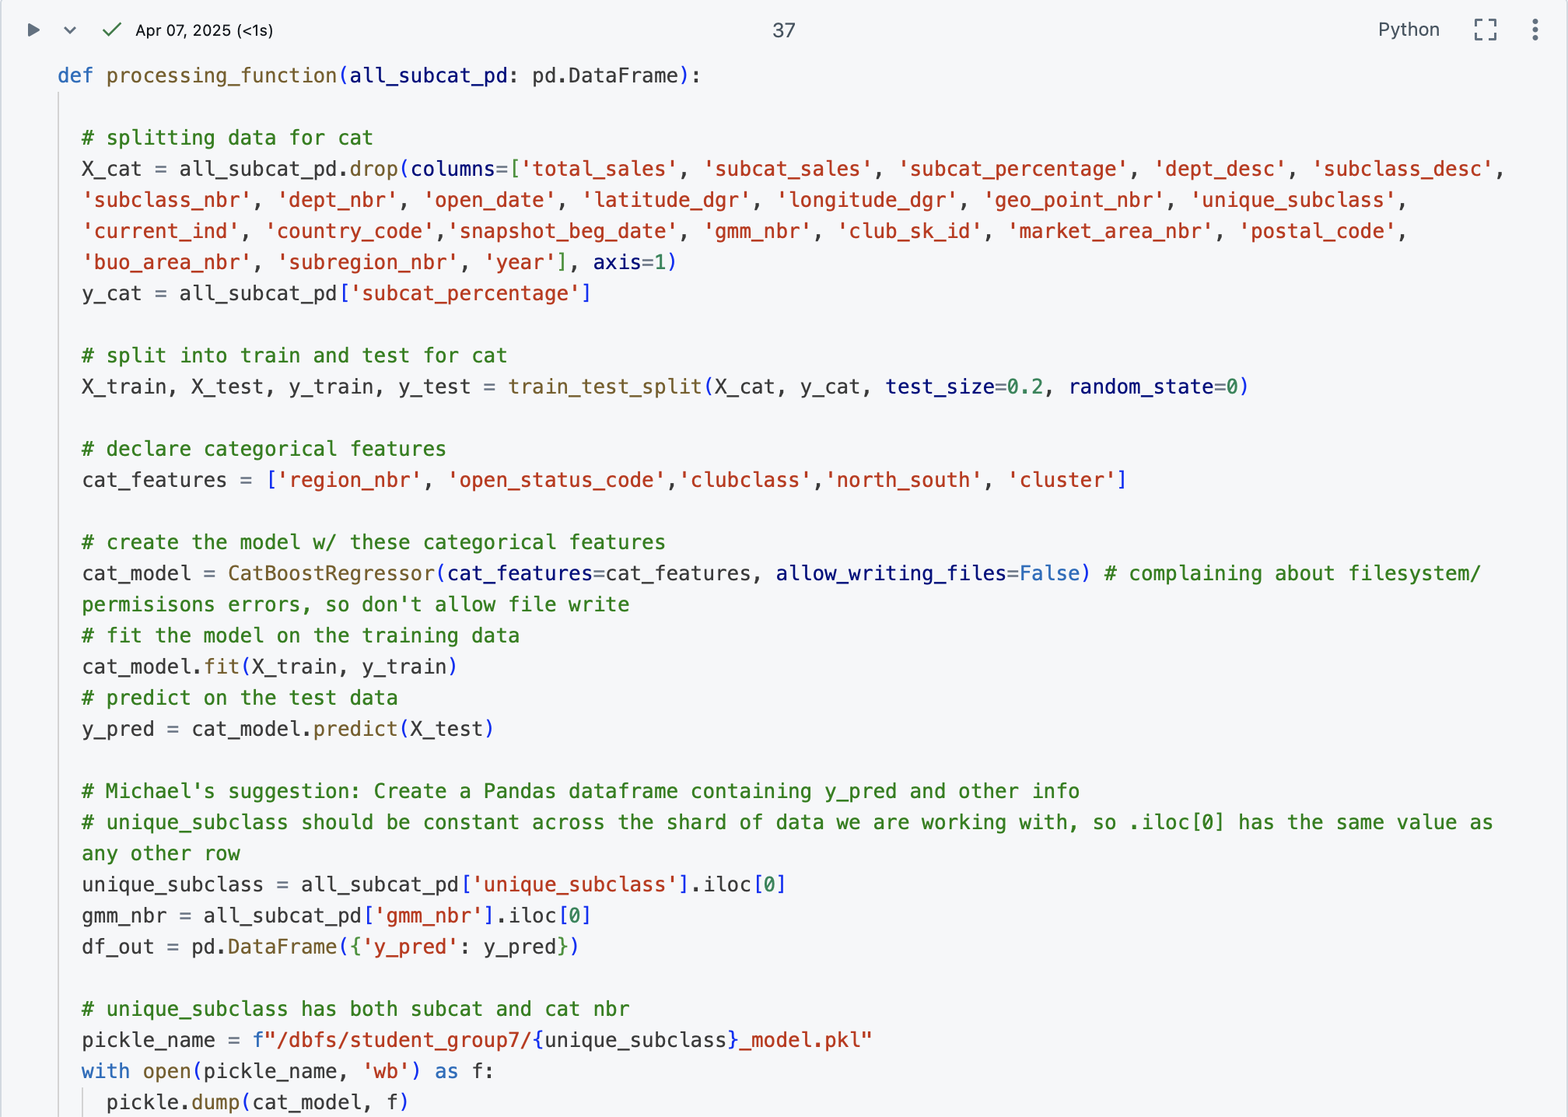
Our Processing Function
Includes code for our CatBoost model
Variables that we are keeping and dropping
Running and fitting the model
Outputs data frame with predictions, and every unique_subclass into a .pkl file
Helps us later pull the files for each subcategory without re-running the model

Slide 18
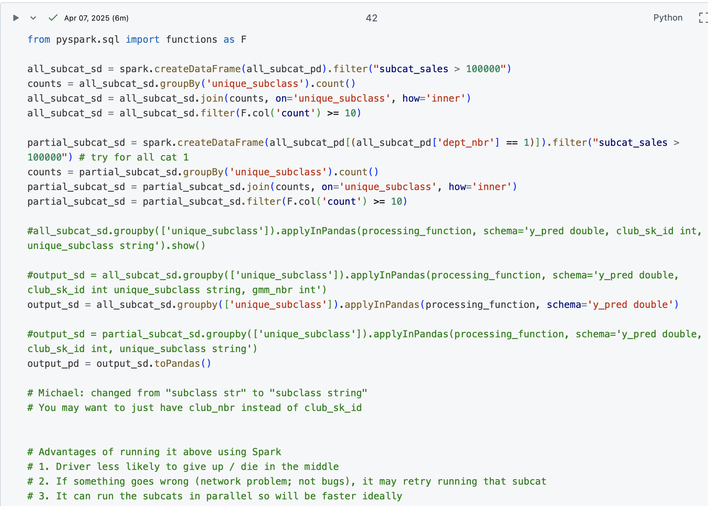
How we Implemented our Processing Function
Using the processing function from the last slide, we were able to implement it to all subcategories:
By using apply() in Pandas
By using Spark to run the models using the apply() in Pandas function, it:
Increased processing efficiency and time
Allowed for no crashes due to the use of multiple drivers
Used results to pull feature importances

Slide 19
Results & Conclusions

Slide 20
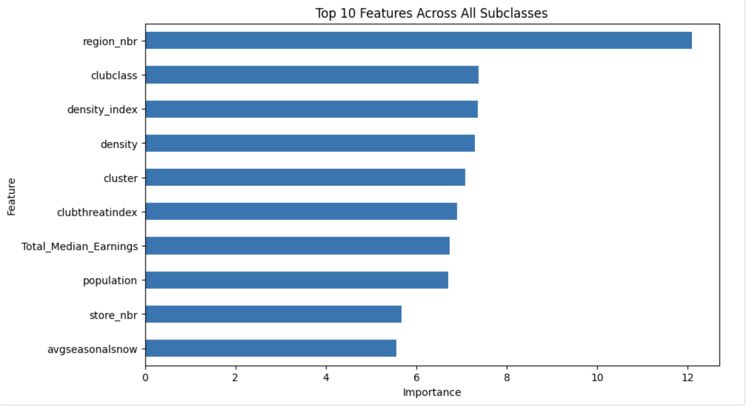
Feature Importances Across All Subcategories
High-level overview of the features that are most impactful across all items/subcategories at Sam's Club
Provided a baseline for further analysis into GMMs (general merchandise areas)
Allows for comparison between average importance and GMM-specific importance

Slide 21
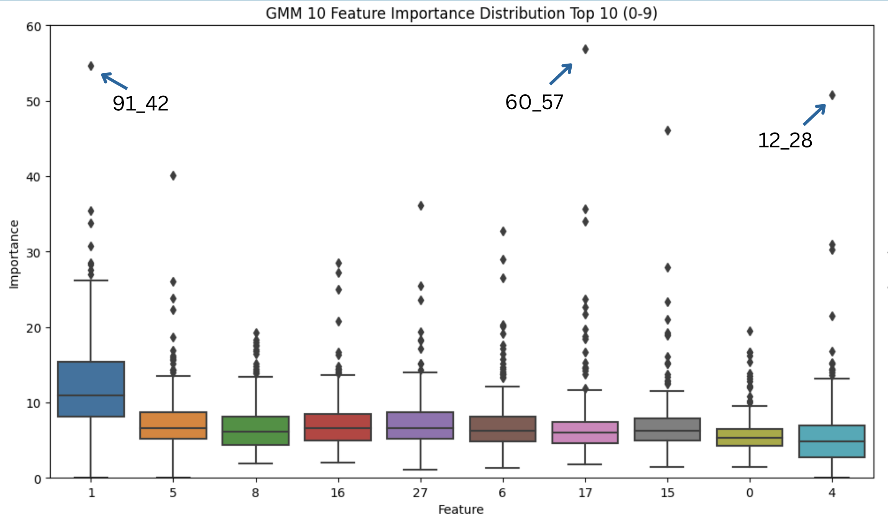
Feature Importances per GMM
GMM-level overview of the features that are most impactful across all subcategories within that GMM at Sam's Club
Box-plots allow for easy outlier detection
Outliers help provide an intermediate result, which represents a subcategory that is strongly affected by that specific feature
To be used in further analysis

Slide 22
Key Takeaways
High-Level
GMM-Level
Subcategory-Level
Identified the features with the most impact to sales across all subcategories
Made logical business-sense, but not particularly actionable
Identified the difference in feature importance between different GMMs
Helps to see which GMMs are more reliant on certain features for sales
Identified features which have more impact on some subcategories than others
Identified outliers; subcategories where certain features mattered significantly more than their average impact

Slide 23
Further Exploration – ⏰
01
03
02
04
Assumptions
More Robust Zip Codes
Our data pipeline included some assumptions that would need to be verified for future work (i.e. # items sold per subcat across clubs)
Use not only exact club zip codes, but find local zip codes as well
People from surrounding zip codes visit clubs too
Model Performance
Expand Item Analysis
While model performance in terms of prediction wasn't our goal, it could stand to be improved
If time allows, expand our analyses to include more items than the item categories chosen by us and our industry partner

Slide 24
Future Work
01
02
Following Immediate Steps
Actionable Insights
After strengthening and expanding the analysis, feature extraction can be performed again, and analyzed on a deeper level
After a deeper analysis of feature importances:
Knowing which features are predictive, and which values (items or subcategories) predict a better or worse sales performance, one can recommend which items should be added or removed based on club characteristic's predictions

Slide 25
Conclusions
01
03
02
04
Surfaced Actionable Insights
Scalable and Interpretable
ML models surfaced actionable insights into item performance by club attributes and demographics
This project's framework is both scalable and interpretable for real-world use
Found Some Key Features
Strong Foundation
Some key features we found included: regional demographics, climate, competition proximity
This project sets a strong foundation for future optimization efforts in retail strategy

Slide 26
Appendix

Slide 27
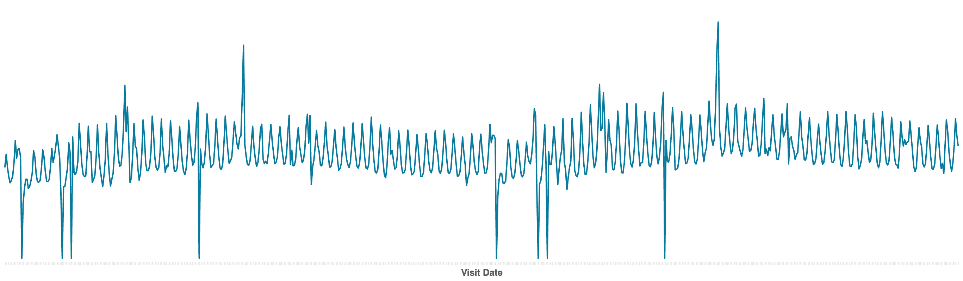
Sales ($) Analysis – Fresh Category
Sales over 2-year range
Sales ($)

Slide 28
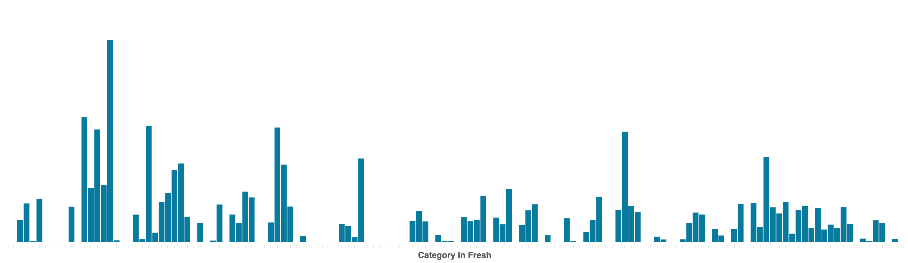
Subcategory Analysis – Fresh Category
Sales ($)

Slide 29
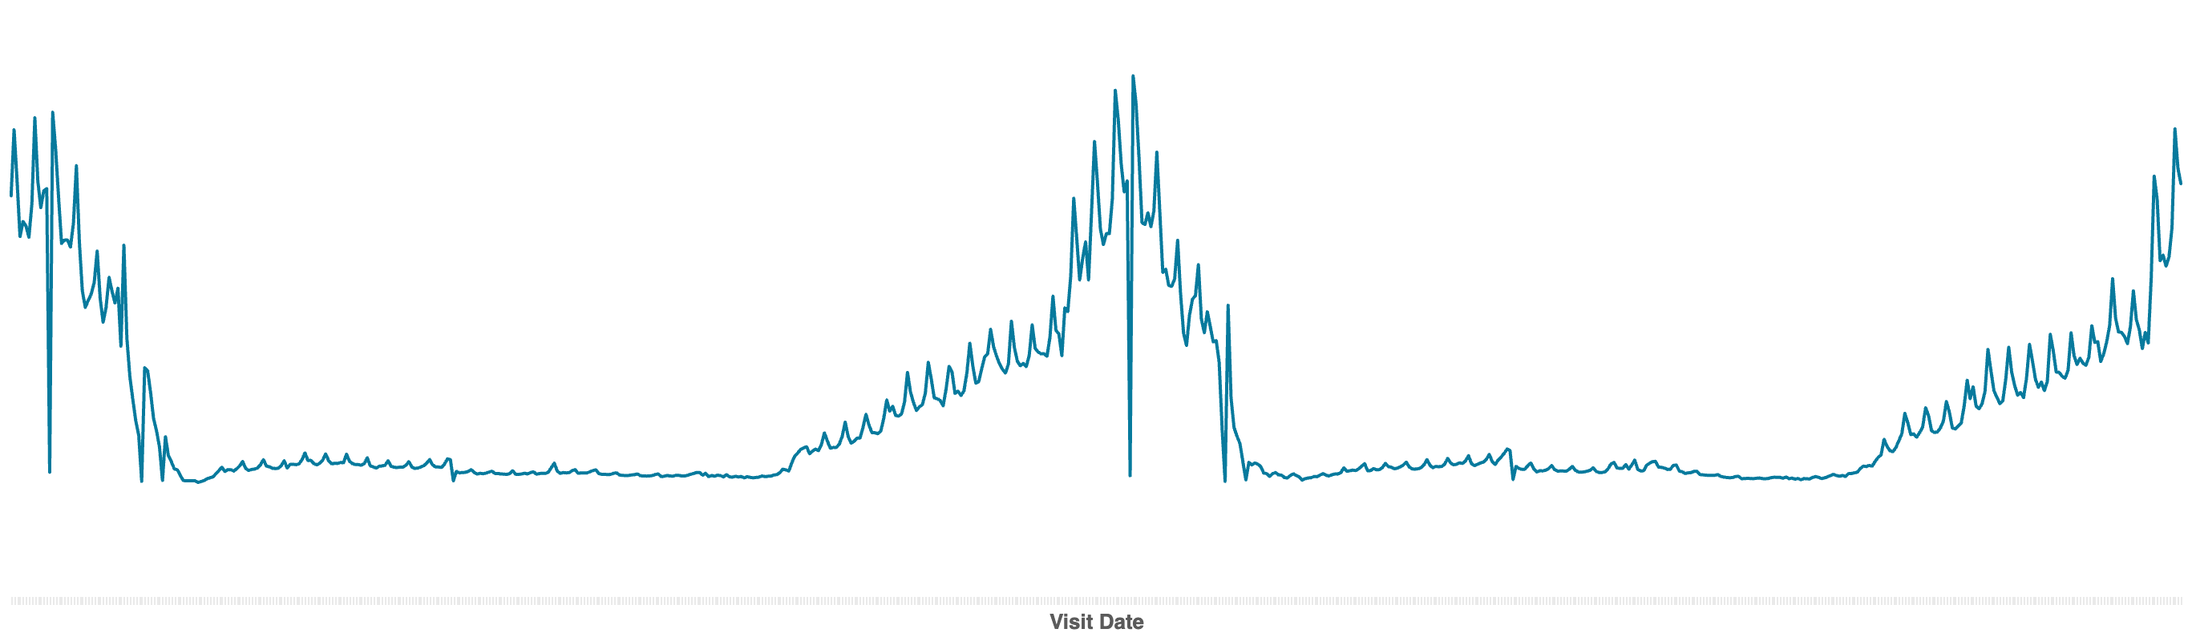
Sales ($) Analysis – General Merchandise Category
Sales over 2-year range
Sales ($)

Slide 30
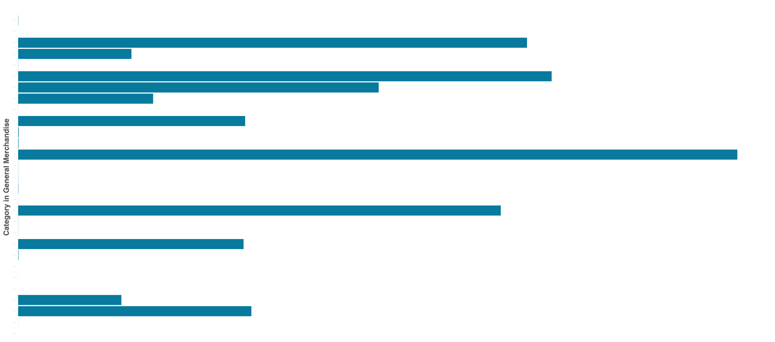
Subcategory Analysis – General Merchandise Category
Sales ($)

Slide 31
Works Cited
Bureau, U. C. (2023, October 11). Census datasets. Census.gov. https://www.census.gov/data/datasets.html
McKinsey. (2019, October). https://www.mckinsey.com/~/media/mckinsey/industries/retail/how we help clients/big data and advanced analytics/mck_retail_analytics_brochure_v10.pdf
Optimizing store space with machine learning. Optimizing store space with machine learning | 84.51°. (n.d.). https://www.8451.com/knowledge-hub/technology/optimizing-store-space-with-machine-learning/

Slide 32
Thank You!
Questions?

